Slide 1
BUSINESS INSIGHTS
Presented by: Trilok Reddy
Last updated: September 6th, 2022

Slide 2
Table of Contents
Business Insights
Purpose Statement(what are we talking about)
Telling Story by Data
Conclusion

Slide 3
What are we talking about ?
Objective:
To identify patterns in business on various metrics using data and use this data to help to grow our business
To improve overall revenue of the company
To reduce expenditure of the company

Slide 4
Telling a story by data
We have created a functional Power BI dashboard consisting of various views like the finance and sales view by which users can draw various insights into the business activities and take data-driven decisions.
The report consists of various pages like:
Home page
Gives the user a brief idea about what's inside the report and consists of clickable icons.
Finance view page
Gives detailed information about the company's total revenue and the user can see revenue by applying different slicers like
Payment status
Year
Sales view page
users can analyze the performance of customers and products by using different slicers like
Product categories
Customer name
Year

Slide 5
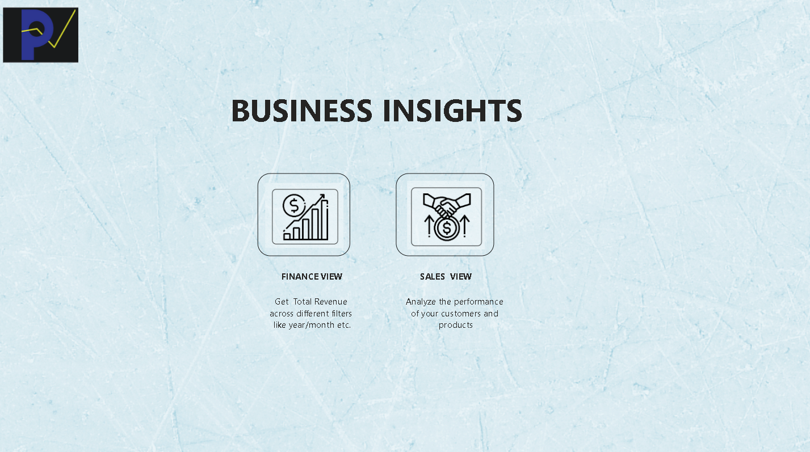
HOME PAGE(Glimpse)

Slide 6
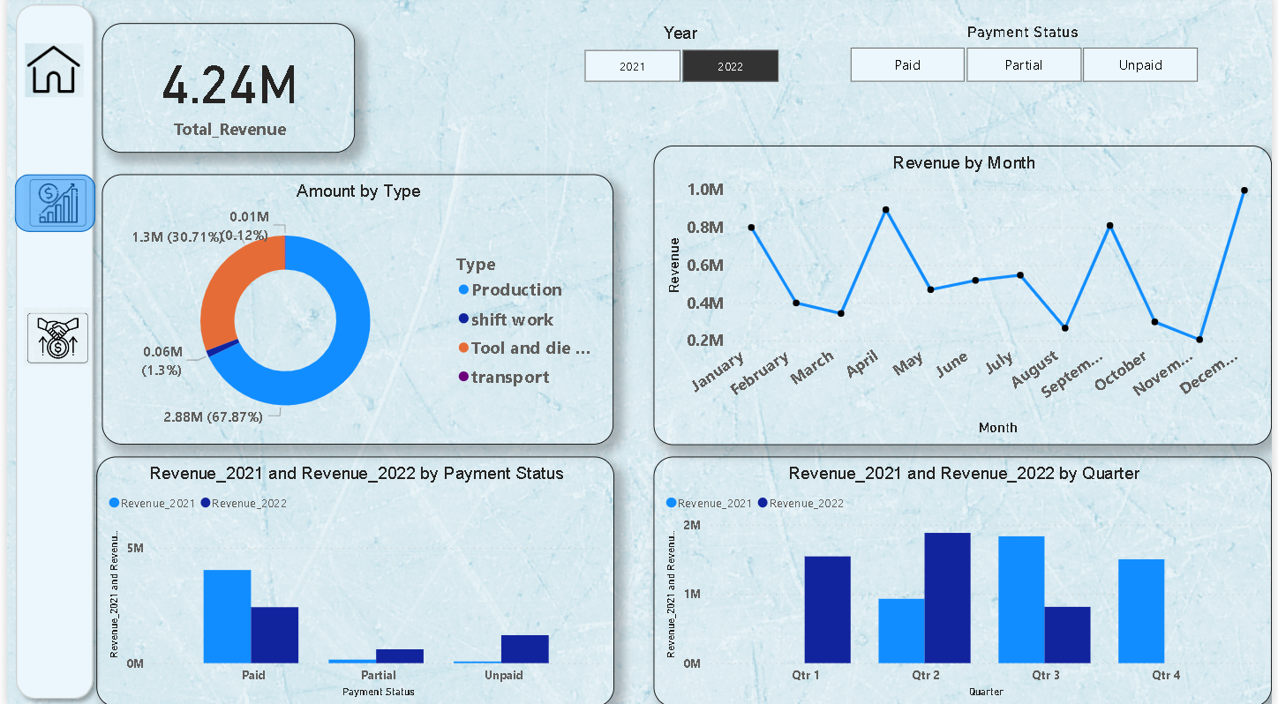
FINANCE VIEW PAGE(Glimpse)

Slide 7
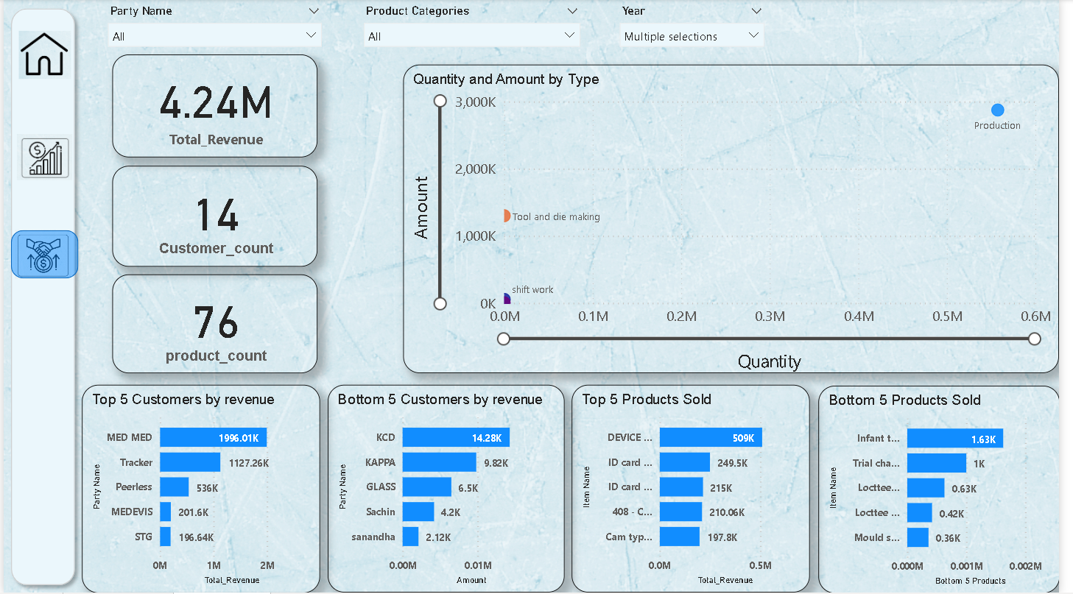
SALES VIEW PAGE(Glimpse)

Slide 8
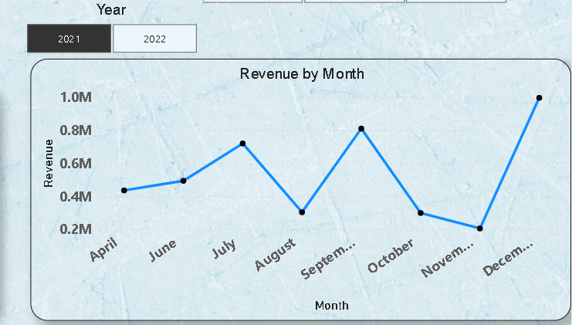
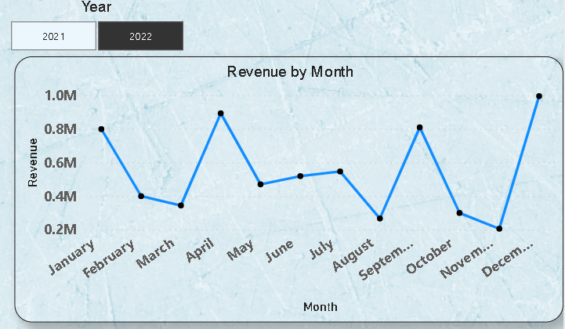
Insights from finance view:
Trends and suggestions:
Majority of the revenue comes in December and the majority of goods sold are from production type Category
• Increase the production capacity of products especially production type category so that supply chain issues are minimized.
In November sales are at the lowest level
•Decrease the production and prepare for December month when sales will peak again.
•As our business mainly rents out machinery it might reduce the cost of expenditure in November month.

Slide 9
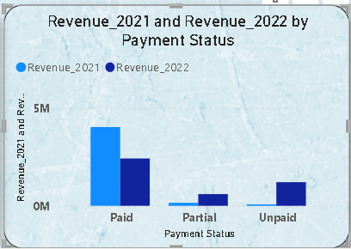
There has been decreasing trend in paid status, whereas partial and unpaid status increased from 2021 to 2022 which might affect the capital available to the company which in turn might affect business expansion and growth.
Can be tackled by providing incentives to the customers who do all the payments at once so that others will be motivated to do the same which in turn has benefits like:
Increases the capital availability
Reduces our dependencies on external borrowings
On the downside business can also decrease as many customers may not be able to pay direct cash at the time of purchase this should be handled in a balancing way
Primarily our focus should be first to reduce the unpaid status and move the unpaid status customers to partially paid customers and there on from partially paid to paid customers.

Slide 10
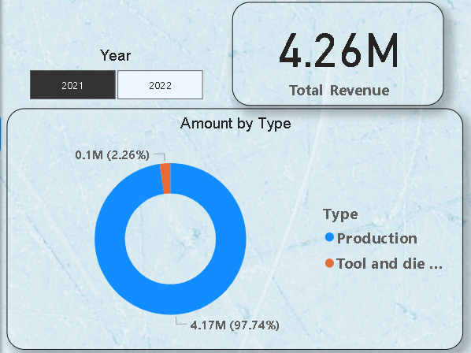
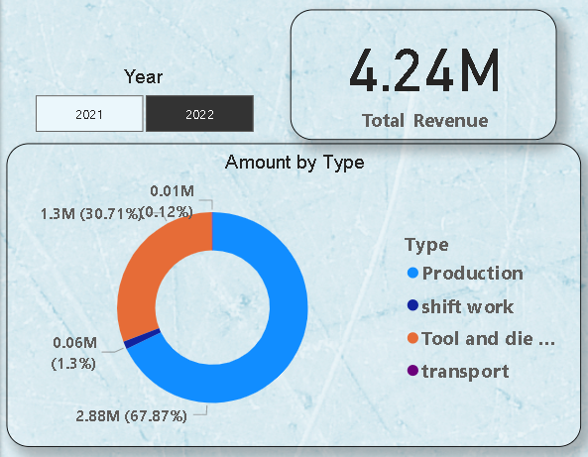
Product categories analysis:
A major chunk of revenue comes from the production type and the rest of the categories contribute marginally compared to the production type
Although the transportation category was introduced in 2022 its performance is below par and we are supplying that product to only one customer
We can either discontinue the product and focus on our most selling products or else we should work on it to improve its sales.
In 2021 we were producing only 2 types of products but even after introducing 2 new product categories in 2022 their contribution to revenue is negligible and in fact revenue decreased in 2022 in comparison with 2021.
we should try to find out the reason for their low performance and to increase the sales of these products discount can be given to the customers initially.

Slide 11
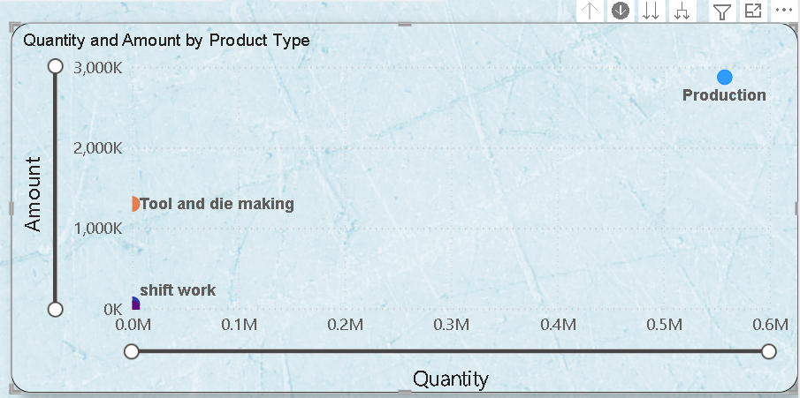
Insights from Sales view:
Aim: To sell more quantity of products and generate more income.
Trends and Suggestions:
we are using a scatter plot to generate meaningful insights ,our goal is to move the products and customers to the top right quadrant so that revenue is maximized.
As it is evident that production category products are performing very well and the rest are not performing as desired.
Apart from focusing on products that are performing well, our focus should be on the category of products that are performing averagely(i.e. tools and die marketing) and move them to the top right quadrant.

Slide 12
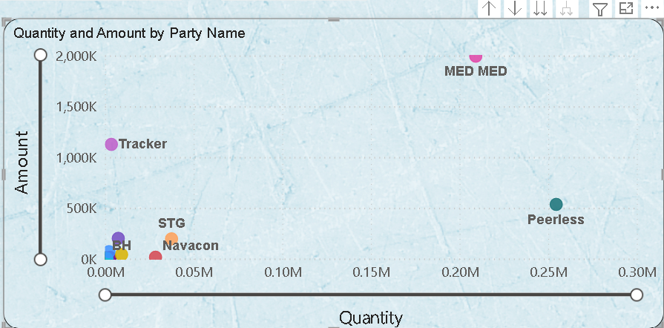
we can follow a similar approach as we followed in product category types to increase revenue from individual customers and move all the customers to the top right quadrant.
Top 5 and Bottom 5 Customers:
For customers who are generating more revenue we can provide seasonal discounts so that they will be motivated and on the flip side our sales will also increase
The main reason for low performing customers is we are selling less than 3 products only to these
customers .
our primary aim will be to sell more product categories so that they can move to the top right quadrant

Slide 13
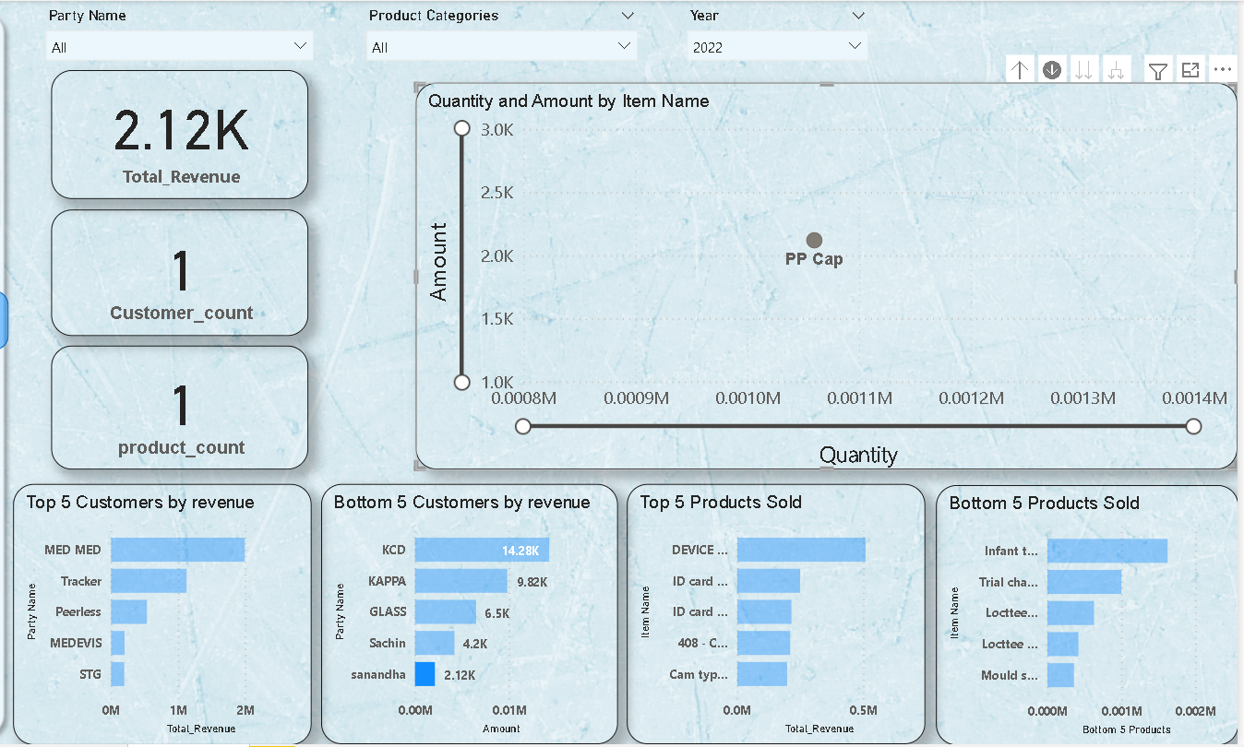

Slide 14
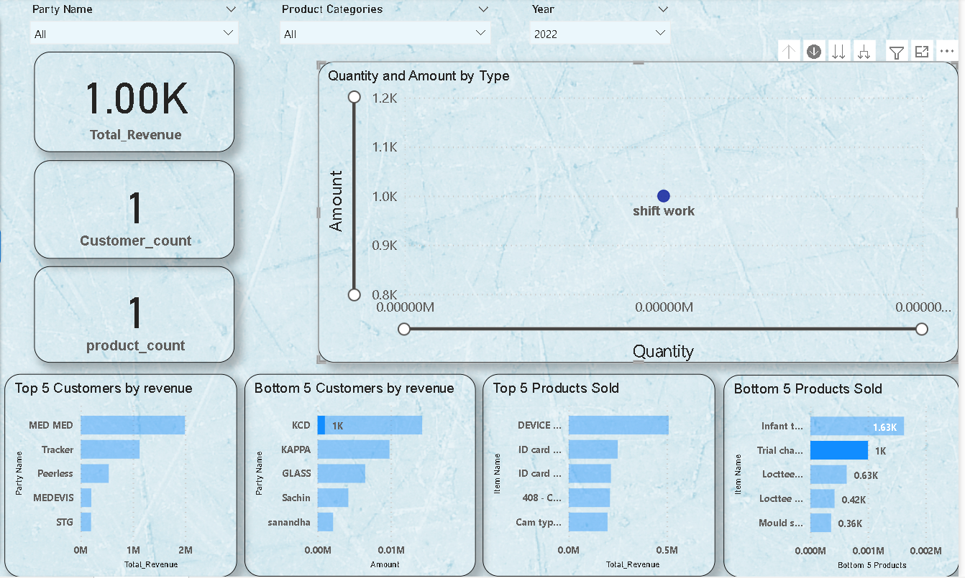
Top 5 and Bottom 5 Products:
Majority of our top selling products are purchased by top customers.
we need to expand our customer base and try to sell products to various customers, it will ensure 2 things:
our dependency on some customers will be minimized
our revenue sources will be expanded
Revenue is negligible for the bottom 5 products so we can discontinue these products so that our production cost decreases and we can channel our focus on products that are performing averagely and try to improve those products.

Slide 15
CONCLUSION
Our business is growing at a decent pace and we have generated around 8.5 million in revenue in the past 2 year, as our business is still in the nascent stage and with passing time we can collect more data on various other parameters which will help us to analyze the trends even more accurately and we can make data-driven decisions that will eventually help the business to grow.
The main focus should be to increase the revenue by:
Acquiring new customers
Increase the sales from existing customers
Concentrate on high-performing products
Try to identify the products which are low performing and improve them
Reducing the production cost by following trends

Slide 16
THE END

